Slide 1
High HTL Cases WESyS

Slide 2
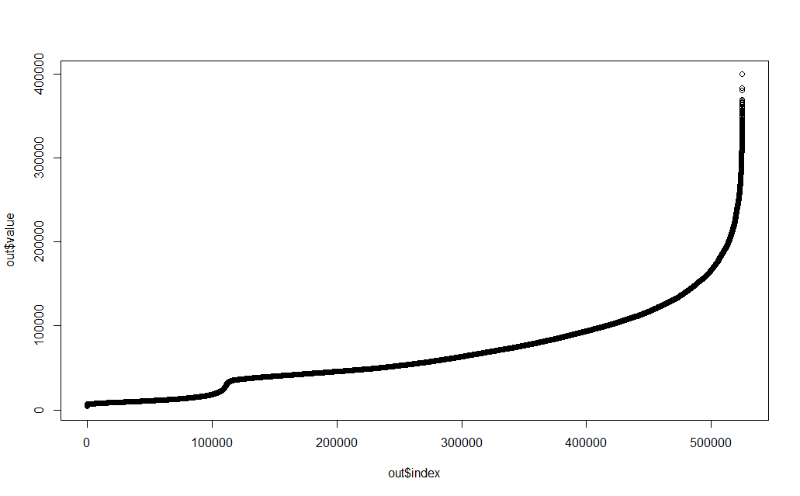
CA HTL Output 2040
run_id = 266199

Slide 3
Run_id 266199 factor settings
Factor | Study | Model
Global Inputs.Comm_Progress_Ratios[HTL] | 0.70835 | 0.8
Global Inputs.Initial Indices of Comm Maturity[HTL] | 0.506592 | 0
Global Inputs.Min Comm Experience for Learning[HTL] | 1650586 | 2000000
Global Inputs.PTC REC Scenario Multiplier[CNG] | 1.356934 | 1
Global Inputs.PTC REC Scenario Multiplier[Elec] | 1.803223 | 1
Global Inputs.RIN Scenario Multiplier[Elec] | 1.118652 | 1
Global Inputs.RIN Scenario Multiplier[PNG] | 1.681152 | 1
Global Inputs.Unit Price Scenario Multiplier[CHP] | 1.546387 | 1
Global Inputs.Unit Price Scenario Multiplier[Elec] | 0.654785 | 1
Global Inputs.Unit Price Scenario Multiplier[PNG] | 0.72998 | 1
Global Inputs.conversion efficiencies[CHP] | 0.68301 | 0.66
Global Inputs.conversion efficiencies[CNG] | 0.717668 | 0.73
Global Inputs.conversion efficiencies[Elec] | 0.300195 | 0.37
Global Inputs.conversion efficiencies[HTL] | 0.788794 | 0.67
Global Inputs.conversion efficiencies[PNG] | 0.677546 | 0.73
Global Inputs.per tonne tipping fee | -1.34888 | 52.21
LF.SB1383 influx Multiplier | 1.472168 | 1
WWTP.AddOnDwellTime | 2.463867 | 3
WWTP.Debt Interest Rate as Pct | 3.06665 | 4
WWTP.DevelopmentDwellTime | 2.267578 | 6
WWTP.Expected Op Cost[HaveCapture, WWTP10to100, CHP] | 108910.4 | 109300
WWTP.Expected Op Cost[NoCapture, WWTP1to10, CNG] | 104269.9 | 100401.9
WWTP.ExpectedFCI[NoCapture, WWTP100Up, PNG] | 38365718 | 39976083
WWTP.ExpectedFCI[NoCapture, WWTP10to100, CHP] | 9250631 | 9456098
WWTP.ExpectedFCI[NoCapture, WWTP10to100, HTL] | 24000398 | 22405331
WWTP.Loan guarantee amount[HTL] | 0.038147 | 0
WWTP.Policy Duration[FCI] | 2.329102 | 0
WWTP.Reqd Rate of Return as Pct | 11.91162 | 8
WWTP.Use Rate Base Funding[Elec] | 0.584717 | 0
WWTP.depreciation period | 27.44629 | 20
WWTP.digester biogas yield | 245.6634 | 283
WWTP.frac organics from SB 1383 go to POTW | 0.826416 | 0.95
WWTP.pipeline length miles | 2.803882 | 1
Learning: lower PR (0.7)
Initial maturity – 0.5 vs 0
Higher conversion efficiency
Low (i.e. negative) tipping fee
Low debt interest rate and high required rate of return.

Slide 4
Early investment and learning are key to high HTL production scenarios

Slide 5
Investment attractiveness varies by POTW size

Slide 6
Large POTWs have the most growth potential

Slide 7
In the absence of competition, HTL has circa 20x more production potential

